Slide 1
CMSC201 Computer Science I for Majors Lecture 22 – Data Representation

Slide 2
Last Class We Covered
Sorting
Bubble
Selection
Quick
Searching
Linear
Binary

Slide 3
Any Questions from Last Time?

Slide 4
Today’s Objectives
To understand how data is represented and stored in memory
Binary numbers
Hexadecimal numbers
Converting
Binary to Decimal
Decimal to Binary
ASCII

Slide 5
Binary Numbers

Slide 6
Binary Numbers
Computers store all information (code, text, images, sound,) as a binary representation
“Binary” means only two parts: 0 and 1
Specific formats for each file help the computer know what type of item/object it is
But why use binary?

Slide 7
Decimal vs Binary
Why do we use decimal numbers?
Ones, tens, hundreds, thousands, etc.
But computers don’t have fingers…
What do they have instead?
They only have two states: “on” and “off”

Slide 8
Decimal Example
How do we represent a number like 50,932?
2 x 10⁰ = 2
3 x 10¹ = 30
9 x 10² = 900
0 x 10³ = 0000
5 x 10⁴ = 50000
------
Total: 50932
ten thousands
thousands
hundreds
tens
ones
5
0
9
3
2
10⁴
10³
10²
10¹
10⁰
Decimal uses 10 digits, so…

Slide 9
Another Decimal Example
6 | 7 | 4 | 9 | 3
10⁴ | 10³ | 10² | 10¹ | 10⁰
10000 | 1000 | 100 | 10 | 1
60000 | 7000 | 400 | 90 | 3
60000+7000+400+90+3 = 67493

Slide 10
Binary Example
Let’s do the same with 10110 in binary
0 x 2⁰ = 0
1 x 2¹ = 2
1 x 2² = 4
0 x 2³ = 0
1 x 2⁴ = 16
--
Total: 22
sixteens
eights
fours
twos
ones
1
0
1
1
0
2⁴
2³
2²
2¹
2⁰
Binary uses 2 digits, so our base isn’t 10, but…

Slide 11
Binary to Decimal Conversion
Step 1: Draw Conversion Box
Step 2: Enter Binary Number
Step 3: Multiply
Step 4: Add
2⁹ | 2⁸ | 2⁷ | 2⁶ | 2⁵ | 2⁴ | 2³ | 2² | 2¹ | 2⁰
512 | 256 | 128 | 64 | 32 | 16 | 8 | 4 | 2 | 1
1 | 0 | 1 | 0 | 0 | 0 | 1 | 1 | 0 | 1
512 | 0 | 128 | 0 | 0 | 0 | 8 | 4 | 0 | 1
128 + 0 + 0 + 0 + 8 + 4 + 0 + 1 = 141

Slide 12
Exercise: Converting From Binary
What are the decimals equivalents of…
101
1111
100000
101010
0010 1010
1000 0000
Longer binary numbers are often broken into blocks of four digits for the sake of readability

Slide 13
Exercise: Converting From Binary
What are the decimals equivalents of…
101 = 4+0+1 = 5
1111 = 8+4+2+1 = 15
100000 = 32+0+0+0+0+0 = 32
101010 = 32+0+8+0+2+0 = 42
0010 1010 = 32+0+8+0+2+0 = 42
1000 0000 = 128+...+0+0 = 128

Slide 14
Decimal to Binary Conversion
Step 1: Draw Conversion Box
Step 2: Compare decimal to highest binary value
Step 3: If binary value is smaller, put a 1 there and
subtract the value from the decimal number
Step 4: Repeat until 0
Convert 163 to binary
2⁹ | 2⁸ | 2⁷ | 2⁶ | 2⁵ | 2⁴ | 2³ | 2² | 2¹ | 2⁰
512 | 256 | 128 | 64 | 32 | 16 | 8 | 4 | 2 | 1
1 | 0
1 | 0 | 0 | 0
1
1
163-128 = 35
35-32 = 3
3-2=1
1-1=0

Slide 15
Converting to Binary
What are the binary equivalents of…
9
27
68
216
255

Slide 16
Converting to Binary
What are the binary equivalents of…
9 = 1001 (or 8+1)
27 = 0001 1011 (or 16+8+2+1)
68 = 0100 0100 (or 64+4)
216 = 1101 1000 (or 128+64+16+8)
255 = 1111 1111 (or 128+64+32+16+8+4+2+1)

Slide 17
Binary Tips and Tricks
Some “sanity checking” rules for conversions:
Binary can only be 1 or 0
If you get “2” of something, it’s wrong
Odd numbers must have a 1 in the ones column
Why? (And what’s the rule for even numbers?)
Each column’s value is the sum of all of the previous columns (to the right) plus one
In decimal, what column comes after 999?

Slide 18
Hexadecimal Numbers

Slide 19
Decimal Representation
Decimal uses 10 digits
Decimal, deci = 10
The digits used are 0, 1, 2, 3, 4, 5, 6, 7, 8, and 9
hundred thousands
ten millions
ten thousands
thousands
millions
hundreds
tens
ones
9
8
7
5
4
2
1
0
10⁷
10⁶
10⁵
10⁴
10³
10²
10¹
10⁰

Slide 20
Binary Representation
Binary uses 2 digits
Binary, bi = 2
The digits used are 0 and 1
one hundred and twenty-eights
sixty-fours
thirty-twos
sixteens
eights
fours
twos
ones
1
0
0
1
1
1
1
0
2⁷
2⁶
2⁵
2⁴
2³
2²
2¹
2⁰

Slide 21
Hexadecimal Representation
Hexadecimal (or just “hex”) uses 16 digits
Hexadecimal, hex = 6 plus deci = 10 → 16
The digits used are 0, 1, 2, 3, 4, 5, 6, 7, 8, and 9
And letters A (10), B (11), C (12), D (13), E (14), and F (15)
two hundred sixty-eight million four hundred thirty-five thousand four hundred and fifty-sixes
sixty-five thousand five hundred and thirty-sixes
sixteen million seven hundred seventy-seven thousand two hundred and sixteens
one million forty-eight thousand five hundred and seventy-sixes
four thousand and ninety-sixes
two hundred and fifty-sixes
sixteens
ones
F
D
A
8
6
3
1
0
16⁷
16⁶
16⁵
16⁴
16³
16²
16¹
16⁰

Slide 22
Hexadecimal Representation
Hexadecimal (or just “hex”) uses 16 digits
Hexadecimal, hex = 6 plus deci = 10 → 16
The digits used are 0, 1, 2, 3, 4, 5, 6, 7, 8, and 9
And letters A (10), B (11), C (12), D (13), E (14), and F (15)
268435456s
16777216s
1048576s
sixteens
65536s
4096s
256s
ones
F
D
A
8
6
3
1
0
16⁷
16⁶
16⁵
16⁴
16³
16²
16¹
16⁰

Slide 23
Hex to Binary Conversion
A hexadecimal digit can be easily represented as four digits of binary (with leading zeros)
This makes conversion very simple
7A0F becomes 0111 1010 0000 1111
1100 0010 0110 1001 becomes C269
Hex | Binary | Hex | Binary | Hex | Binary | Hex | Binary
0 | 0000 | 4 | 0100 | 8 | 1000 | C | 1100
1 | 0001 | 5 | 0101 | 9 | 1001 | D | 1101
2 | 0010 | 6 | 0110 | A | 1010 | E | 1110
3 | 0011 | 7 | 0111 | B | 1011 | F | 1111

Slide 24
Hex to Decimal Conversion
Possible to convert between decimal and hex
But it requires calculating out multiples of 16
Simpler to make a “side trip” to binary as an in-between step when converting
240 becomes 1111 0000 becomes F0
F0 is equal to (15 * 16¹) + (0 * 16⁰) = 240 + 0 = 240
7D becomes 0111 1101 becomes 125
7D is equal to (7 * 16¹) + (13 * 16⁰) = 112 + 13 = 125

Slide 25
Number System Notation
Because number systems share a subset of the same digits, it may be confusing which is which
For example, what is the value of 10?
In decimal it’s 10, in binary it’s 2, and in hex it’s 16
To prevent this, numbers may often be prefixed with 0b, 0d, or 0x (binary, decimal, hex):
0b1100 is binary, and has a value of 12
0x15 is hexadecimal, and has a value of 21

Slide 26
ASCII Values

Slide 27
ASCII Values
ASCII is how text is represented in computers
Just like binary is how numbers are represented
In ASCII, every character has a unique, individual numerical code
Lowercase and uppercase characters are separate
Codes go from 0 to 127
Why 127?

Slide 28
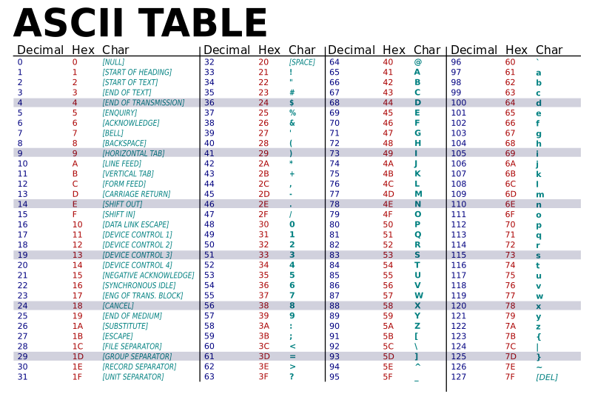

Slide 29
“control” characters
uppercase letters
symbols & numbers
lowercase letters

Slide 30
Comparing Strings
The values of the ASCII characters are used when comparing strings together
Which can lead to some “weird” results
>>> "cat" < "dog"
True
>>> "cat" < "Dog"
False
>>> "DOG" < "dog"
True
?
<

Slide 31
More on Comparing Strings
Gets even more complex when you start adding in numbers and symbols
>>> "2" < "one"
True
>>> "good?" < "good!"
False
>>> "UK" < "U.K."
False

Slide 32
Rules for Comparisons
To avoid (some) of these issues:
Always use .lower() for comparing strings
Pay attention to symbols
e.g., spaces, hyphens, punctuation, etc.
Either remove them, or keep them in mind as part of the order

Slide 33
ASCII Characters to ASCII Values
We can convert between ASCII characters and their values using ord() and chr()
The ord() function takes in a single character, and returns its ASCII value
The chr() function takes in an integer, and returns its ASCII character

Slide 34
Using chr() and ord()
>>> chr(65)
'A'
>>> chr(65+32)
'a'
>>> ord('?')
63
>>> ord("d")
100
>>> ord("e")
101

Slide 35
Project 3

Slide 36
Project 3 Tips
Hopefully you have started by now!
Work on it a little everyday
You have been given some solved puzzles
Which means you don’t need a working solve() to test the other parts of your project
Just load in the solution from the file
Solve the puzzle once, and store the solved puzzle to use it later in your code
Don’t resolve it every time you need it
Make your own puzzles to test!

Slide 37
Project 3 and Deep Copy
You will need to make a deep copy of the 2D list used to hold your Sudoku board
Simply using new = old[:] will not work
We recommend making a function to do this
Test that your function works before using it
Do NOT use the built-in deepcopy() function, or you will lose major points!!!

Slide 38
Do Not Cheat on Project 3
Yes, this project has solutions on the internet
Yes, we have copies of all of them
Yes, we will go looking for new ones after it’s due
Yes, you could pay someone else to do it
Yes, we know of the sites where you can get this done
Yes, we will spot “elegant” code that you didn’t write
Yes, there are libraries to deep copy in python
Yes, you will get points off for using them
You should not be importing anything for this project

Slide 39
Questions?

Slide 40
Announcements
Project 3
Design is due Tuesday, December 4th
Project is due Tuesday, December 11th
Final exam is when?
Friday, December 14th from 6 to 8 PM
Locations will be posted on the course website
Common final

